Slide 1
Unicondylar knee replacement – post-operative imaging audit
Mr Thomas Stringfellow
Miss Sarah Lewis
Dr Rhea Edmonds
Mr Sakis Pollalis

Slide 2
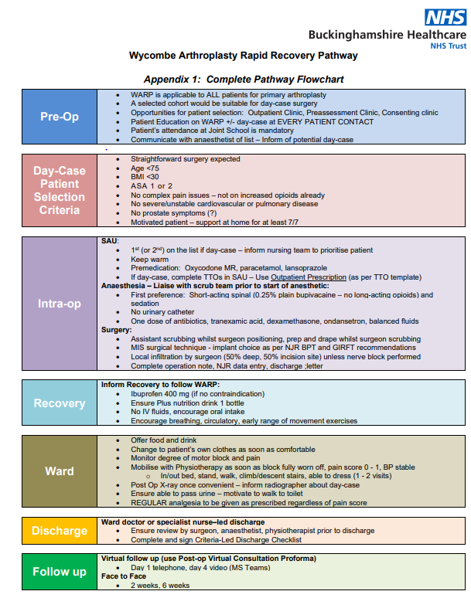
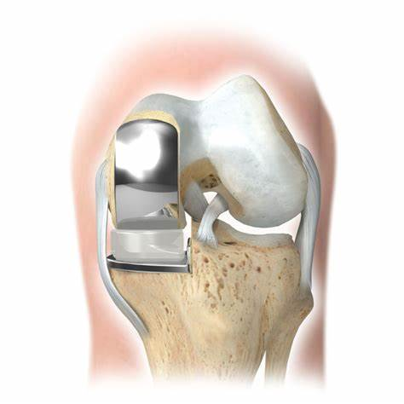
Background
For anteromedial knee OA medial unicondylar knee replacement gives good clinical and functional outcomes.
WARP allows same-day discharge due to reduced post-op pain and early mobilisation.
Post-op radiographs can delay discharge and important for monitoring the implant.

Slide 3
Audit standard
Initial post-op radiograph obtained with fluoroscopy
AP: align beam with tibial component to achieve an end-on-end view
Lateral view: 20-30 flexion with beam centred on femoral component
10° of mal-orientation of the femoral component and 5° mal-orientation of the tibial component do not compromise the outcome (Gulati et al, 2009).

Slide 4
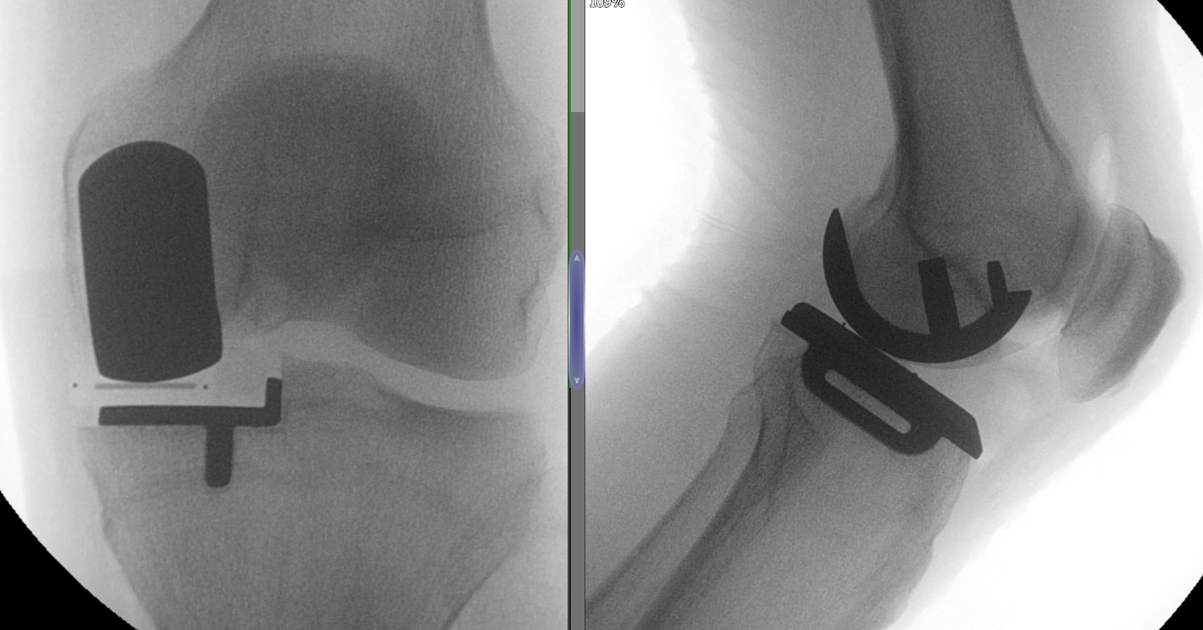
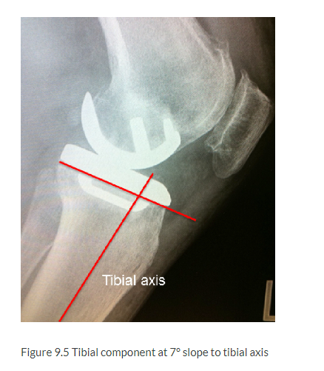
Tibial component
Assess location of vertical cut
Seated prosthesis
Perpendicular (±5°) to the tibial axis
<2mm medial overhang
Cementless- radiolucency shown to disappear over time with WB.
2mm between vertical wall and bearing.

Slide 5
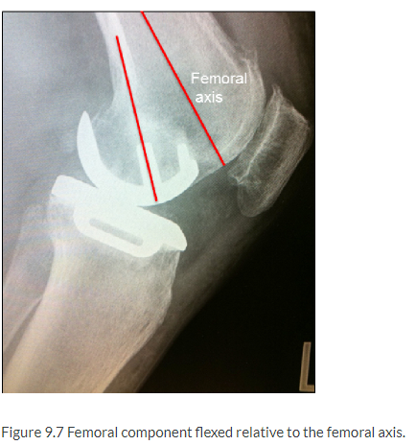
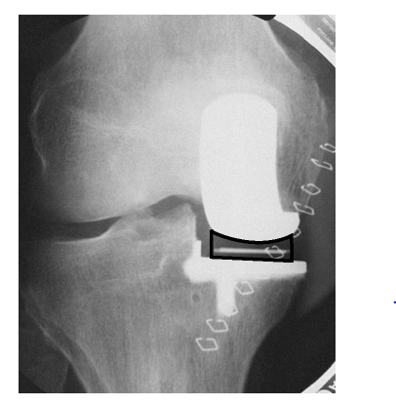
Femoral component
Internally rotated on AP (distal femur int rotates in extension)
10 degrees flexed to the femoral anatomical axis on lateral.

Slide 6
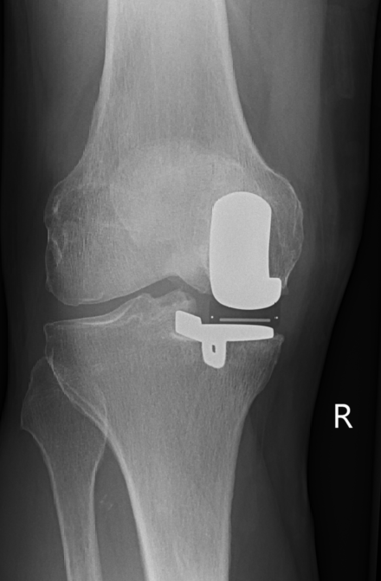
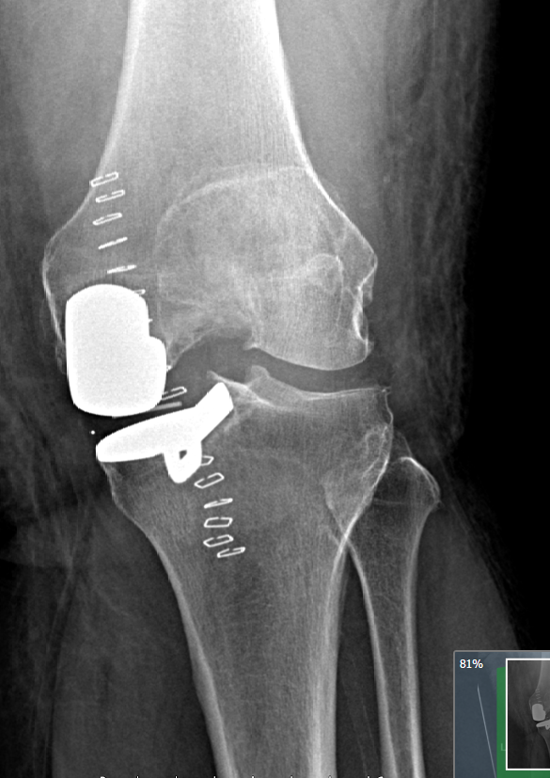
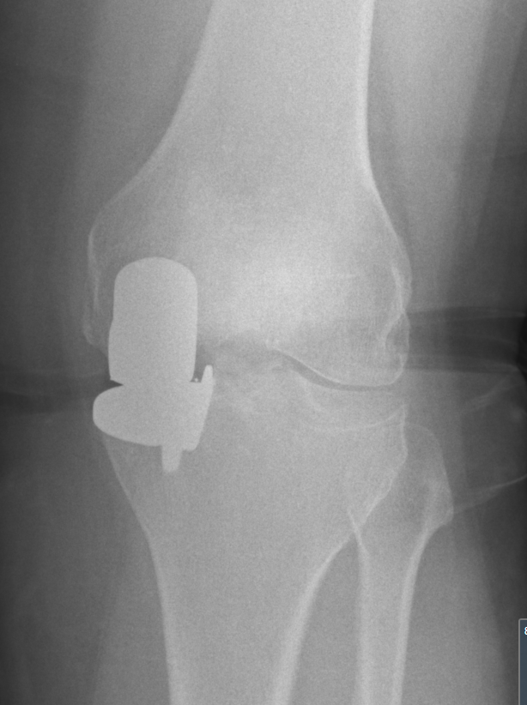
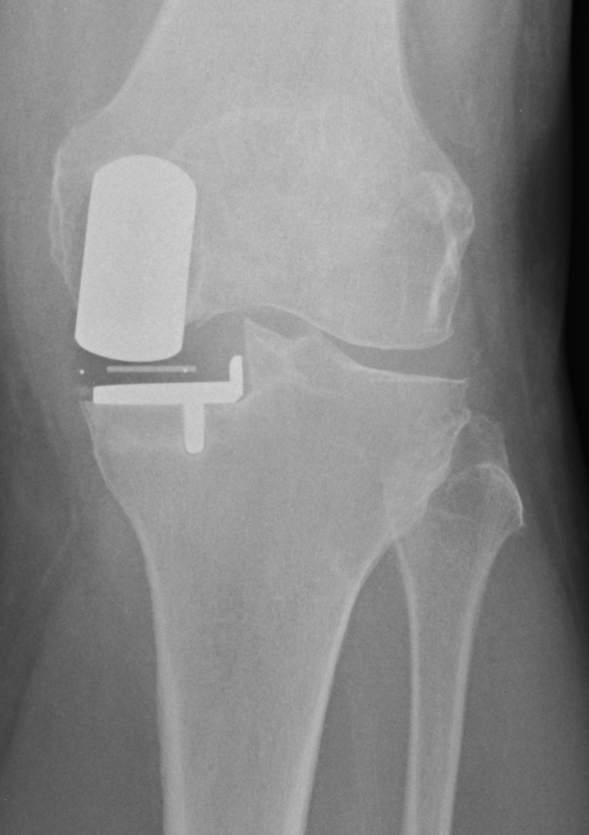
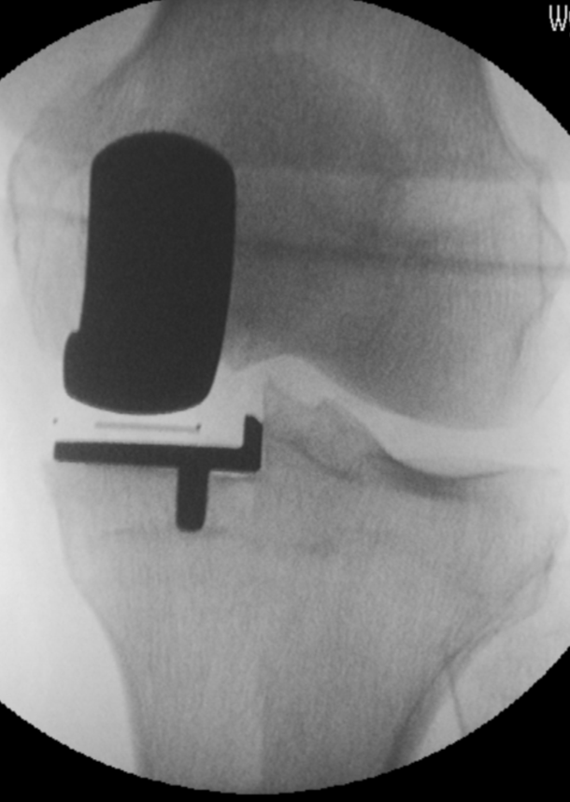
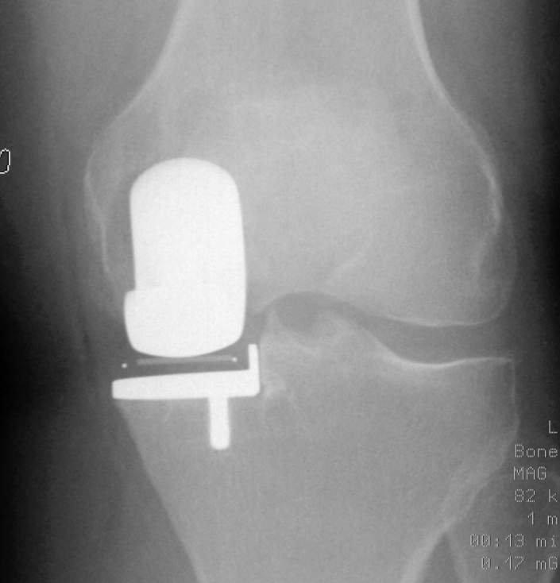
All POOR
Satisfactory (not perfect as vertical wall not straight)
All well aligned

Slide 7
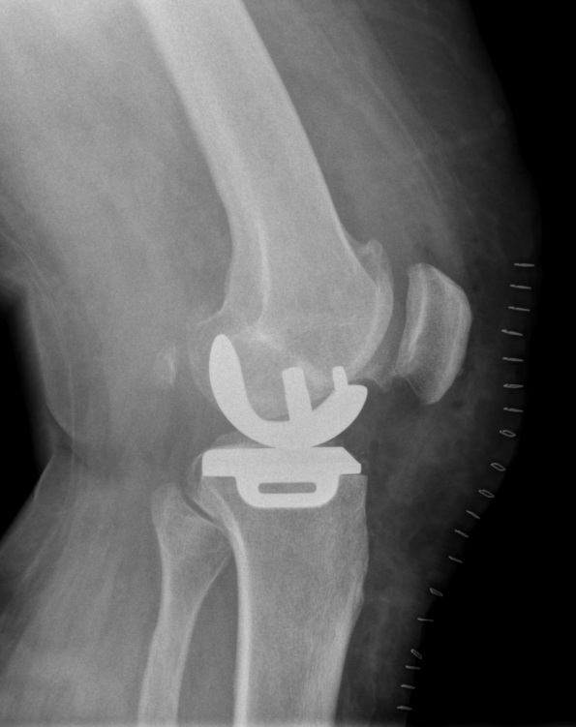
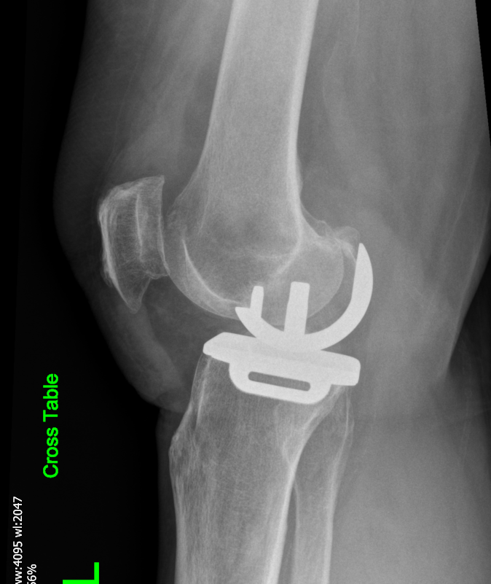
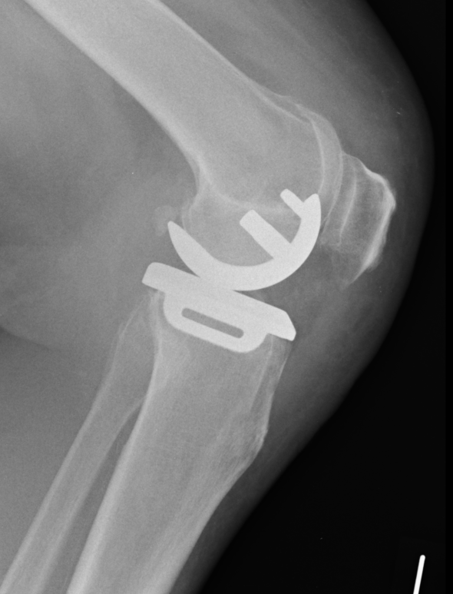
All POOR
Not true laterals, no overlap on condyles
All well aligned
FEM Condyles overlap, true lateral

Slide 8
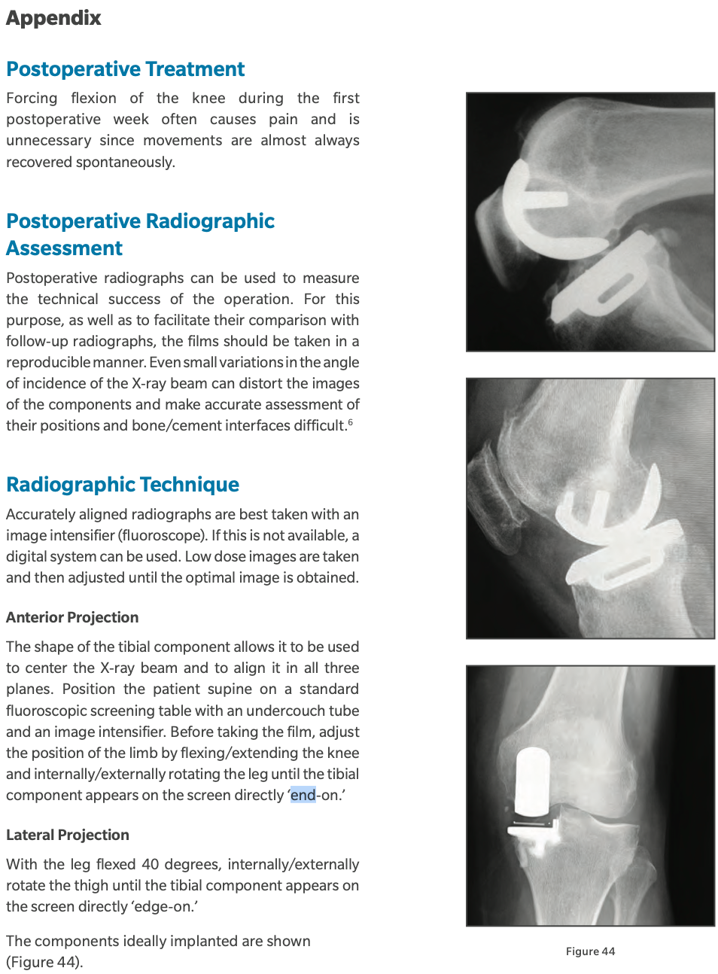
From Zimmer Op tech
Page 28
https://www.zimmerbiomet.com/content/dam/zb-corporate/en/education-resources/surgical-techniques/specialties/knee/oxford-partial-knee/oxford-partial-knee-microplasty-instrumentation-surgical-technique1.pdf

Slide 9

Further resources
Radiographer guidelines:
https://oxfordkneeinfo.com/documentation/9-postoperative-management-and-radiography/postoperative-radiology/
Op tech:
https://www.zimmerbiomet.com/content/dam/zb-corporate/en/education-resources/surgical-techniques/specialties/knee/oxford-partial-knee/oxford-partial-knee-microplasty-instrumentation-surgical-technique1.pdf

